Slide 1
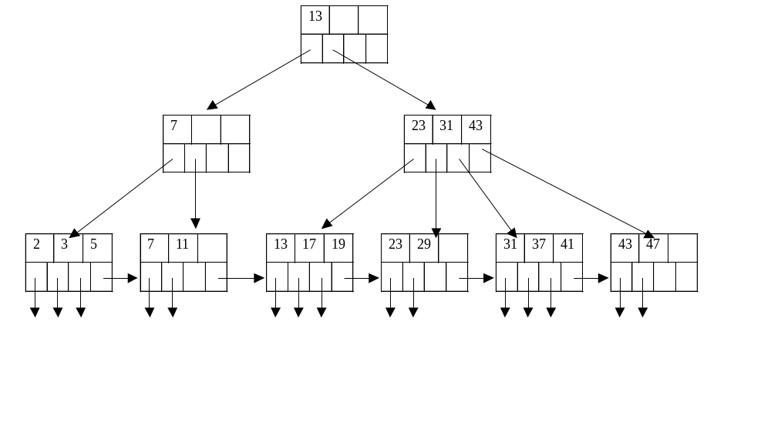
A B+ Tree Example

Slide 2
Don’t want nodes to be too empty
Use at least
  Non-leaf: ⎡(n+1)/2⎤ pointers
  Leaf: ⎣(n+1)/2⎦ pointers to data

Slide 3
Range Queries
SELECT *
FROM R
WHERE R.K > 40
SELECT *
FROM R
WHERE R.K>= 10 AND R.K <=25

Slide 4

Example: Search for records within (10, 25)

Slide 5
Insert into B+tree
(a) simple case
  space available in leaf
(b) leaf overflow
(c) non-leaf overflow
(d) new root

Slide 6
(a) Insert key = 32
n=3
100
30
3
5
11
30
31
32

Slide 7
(a) Insert key = 7
n=3
100
30
7
3
5
3
5
11
30
31
7

Slide 8
(c) Insert key = 160
n=3
100
160
120
150
180
180
150
156
179
160
179
180
200

Slide 9
(d) New root, insert 45
n=3
30
new root
10
20
30
40
1
2
3
10
12
20
25
30
32
40
40
45

Slide 10
Deletion from B+tree
(a) Simple case - no example
(b) Coalesce with neighbor (sibling)
(c) Re-distribute keys
(d) Cases (b) or (c) at non-leaf

Slide 11
(b) Coalesce with sibling
  Delete 50
n=4
10
40
100
10
20
30
40
50
40

Slide 12
(c) Redistribute keys
  Delete 50
n=4
10
40
100
35
10
20
30
35
40
50
35

Slide 13
(d) Non-leaf coalese
  Delete 37
n=4
25
new root
10
20
30
40
25
40
25
26
1
3
10
14
20
22
30
37
40
45
30

Slide 14
B+tree deletions in practice
Often, coalescing is not implemented
  Too hard and not worth it!

